Slide 1



News Summarizer
AIES Project Presentation
Members:
Amarjeet Abdar 02
Yash Pise 03
Pranjal Kabra 17
Vidisha Agarwal 19

Slide 2
Table of contents
01
02
03
04
05
06
Introduction
Tools
Architecture
Code Snippets & Output Screenshot
Future Enhancements
Conclusion and References

Slide 3

01
Introduction

Slide 4

Introduction
The Web-Based Application for Summarizing and Analyzing News Articles addresses the challenges posed by information overload in the digital age.
News articles, vital for staying informed, often overwhelm users with diverse perspectives and compromised credibility.
This application offers a streamlined solution: users input a news article URL, and the application employs Natural Language Processing (NLP), a facet of artificial intelligence, to swiftly generate a concise summary and conduct a sentiment analysis.
NLP enables tasks such as text extraction, summarization, and sentiment analysis, ensuring a nuanced understanding of articles.

Slide 5


Introduction
More than a mere summarization tool, this application is a gateway to informed decision-making.
It empowers users by providing accurate and unbiased insights, allowing them to navigate through biased content.
Moreover, it transparently outlines its features, elucidating the functionalities and underlying technologies, fostering a user-friendly experience.
In a landscape where credibility is crucial, this application emerges as a beacon, offering clarity and efficiency in the often overwhelming world of digital news consumption.

Slide 6
02
Tools

Slide 7
Tools
Web Scraping Module:
Extracts news articles using HTML parsing and regular expressions.
Advantages: Access to current, relevant news articles on various topics.
Challenges: Data quality, legality, and scalability need consideration.
Natural Language Processing (NLP):
Powered by NLP for text processing.
Applications include text extraction, summarization, and sentiment analysis.
Techniques: Named entity recognition, part-of-speech tagging, etc.

Slide 8
Tools
Sentiment Analysis:
Identifies opinions and emotions from text.
TextBlob library analyzes text for polarity and subjectivity scores.
Scores determine positivity, negativity, or neutrality.
Keyword Extraction:
Identifies key phrases and topics for quick content understanding.
TextBlob library extracts keywords based on relevance score.
Top N keywords displayed on GUI with size and font variations.
User-Friendly Interface:
Simple and intuitive design.
Design principles: Simplicity, consistency, clarity, accessibility.
Ensures a clear and efficient user experience.

Slide 9

03
Architecture

Slide 10
Architecture
The architecture of the Web-Based Application for Summarizing and Analyzing News Articles consists of two layers: the presentation layer and the application layer.
Presentation Layer
The presentation layer handles the user interface and user interaction aspects. It consists of the following components:
GUI: Graphical User Interface using tkinter library.
Web Browser: Supports Python 3, newspaper, and textblob libraries.
User: Target users require no technical expertise, just web access and a compatible browser.

Slide 11
Architecture
Application Layer
The application layer implements the processing logic and algorithms that drive the application's functionality. It consists of the following key components and tasks:
Web Scraping Module:
Extracts information from the provided URL using the newspaper library.
Validates URL and ensures data integrity before proceeding.
NLP Module:
Performs summarization and sentiment analysis of extracted article text.
Utilizes the textblob library and employs NLP techniques (e.g., named entity recognition, part-of-speech tagging) for context understanding.
Keyword Extraction Module:
Identifies and extracts relevant keywords from the article text using the textblob library.
Considers factors like frequency, position, length, and diversity to determine keyword relevance.

Slide 12
04
Code Snippets & Output Screenshot

Slide 13
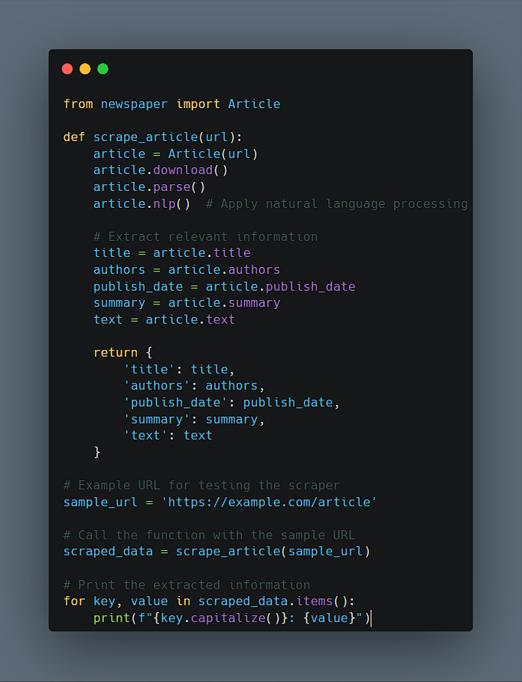
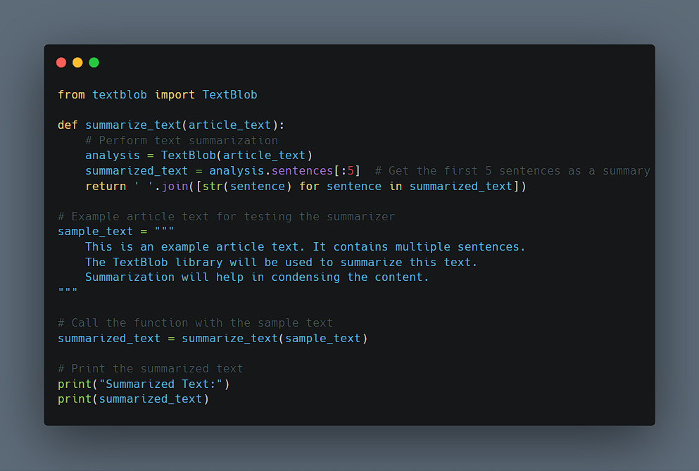
Code Snippets

Slide 14
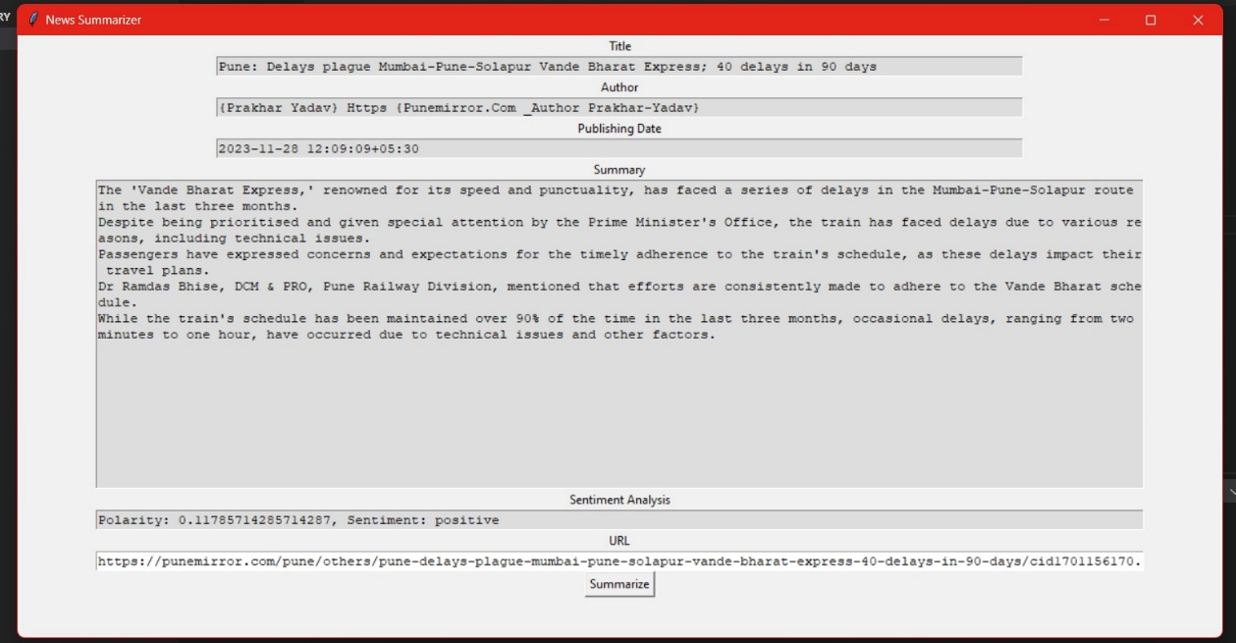
Output Screenshot

Slide 15

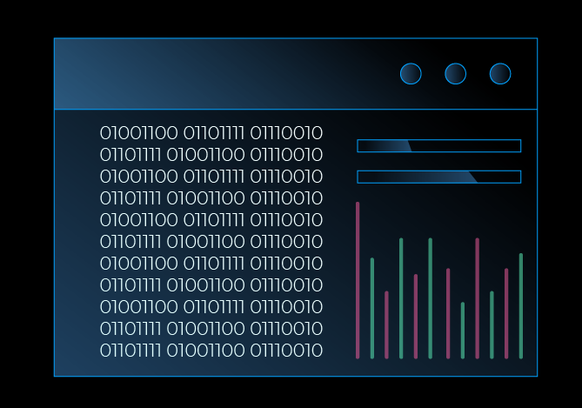
05
Future Enhancements

Slide 16


Future Enhancements
Incorporating User Profiles for Personalization:
Personalized Settings:
Allow users to customize language, summary length, and sentiment analysis format.
Saved History:
Maintain a history of analyzed articles for easy access to past summaries and analyses.
Feedback Mechanism:
Enable users to provide feedback, enhancing features and functionalities.

Slide 17
Expanding Reach with Multilingual Support:
Language Options: Users can choose preferred languages for both input and output.
Translation Services: Integrate translation services for seamless conversion of content into chosen languages.
Multilingual NLP Libraries: Use multilingual NLP libraries for accurate processing of news articles in various languages.
Enhancing Timeliness with Real-Time Updates:
Continuous News Crawling: Ensure the app fetches the latest articles continuously from various sources.
Customized Alerts: Allow users to subscribe to personalized alerts based on interests.
Real-Time Sentiment Analysis: Provide up-to-date insights into changing sentiments around trending events.

Slide 18

06
Conclusion and References

Slide 19
Conclusion
The Web-Based Application for Summarizing and Analyzing News Articles offers significant benefits:
Quick and Efficient: Rapidly summarizes articles, saving users time.
Easy Information Handling: Condenses articles, helping users manage information overload.
Credibility Check: Assists users in evaluating article reliability through analysis.
Comparison Made Simple: Allows easy comparison of perspectives from different sources.
User Empowerment: Equips users to make informed decisions about news consumption.
Anytime Access: Web-based for accessibility from any device or location.
User-Friendly: Simple interface for a smooth and satisfying user experience.

Slide 20

References
The following is a list of references, including research papers, articles, and documentation related to the technologies and methodologies employed in the Web-Based Application for Summarizing and Analysing News Articles:
Utilizing Web Scraping and Natural Language Processing to Better Inform Pedagogical Practice¹
Natural language processing Latest Research Papers | ScienceGate²
Web Scraping and Natural Language Processing for News Sentiment Analysis³
Sentiment-analysis · GitHub Topics · GitHub⁴
Newspaper: Article scraping & curation⁵

Slide 21
THANK YOU!

